Slide 1
Transcriptomics: measuring _______________across the genome
BIO311 01/31/2017

Slide 2
Preview
Experimental design
Microarrays
RNA-Sequencing (RNA-seq)
Example: yeast cell cycle

Slide 3
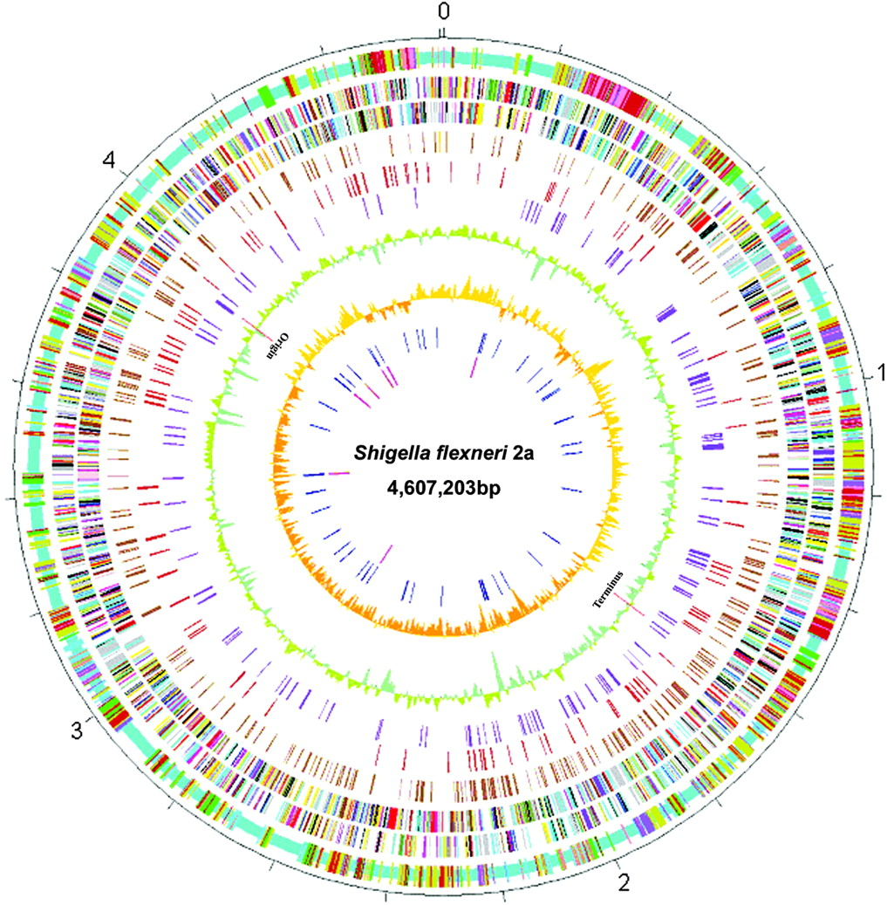
What is a genome?
Bacterial
Image from Nie et al., 2006,7:173

Slide 4
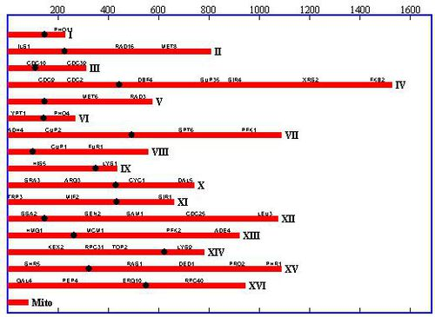
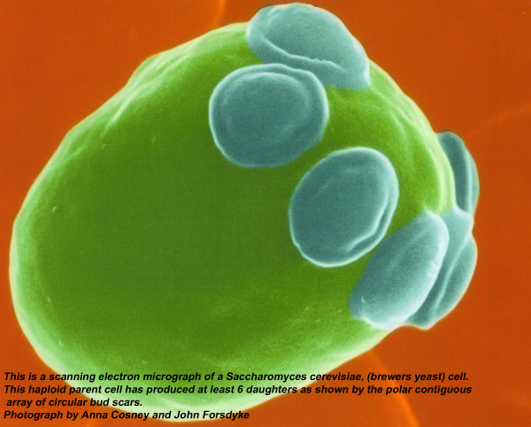
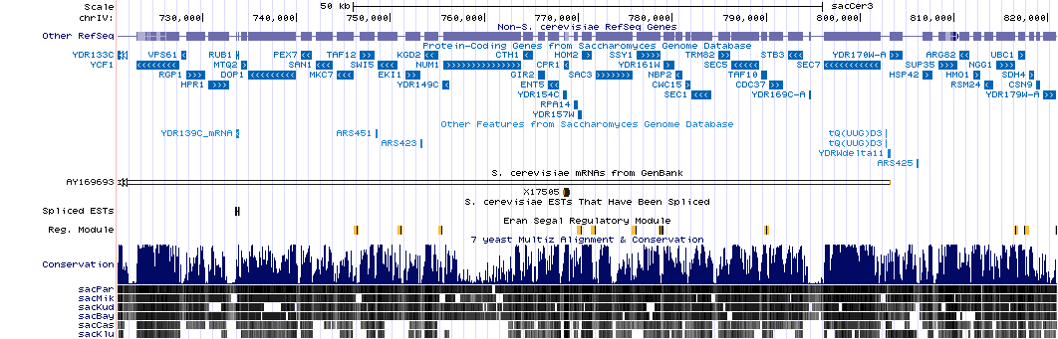
What is a genome?
Image from http://microbewiki.kenyon.edu/index.php/Saccharomyces_cerevisiae_Alt
Image from UCSC genome browser, genome.ucsc.edu

Slide 5
Genome wide expression analysis
Goal: to measure _____________ all genes in genome
RNA levels vary with the following:
Cell ___________
Developmental stage
_________________
_______________of expression under various growth conditions provide useful information as to ___________________________.

Slide 6
Experimental design
A CRUICIAL component for getting biological meaningful results (otherwise, ____________________).
Understanding the ________________is required for _______________.
Example: Yeast cell cycle (synchronization, mutants vs wild type)

Slide 7
Spellman et al., experimental design
___________cells in the cell cycle
___________cells from _____________
Measure _________________over time

Slide 8
Synchronization
Elutriation
Alpha factor
cdc15
Notes:
We will go over the yeast and Halobacterium stress response designs during the “project introduction” class session on March 20.

Slide 9
Mechanical synchrony
Beckman-Coulter Life Sciences

Slide 10
Chemical synchrony
http://profiles.umassmed.edu/profiles/display/133227

Slide 11
Genetic synchrony
Cdc15 – temperature sensitive mutant.
30C – cells go through cell cycle normally
37C – cells arrest.
Back to 30C – release arrest and measure transcription over time.

Slide 12
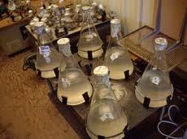
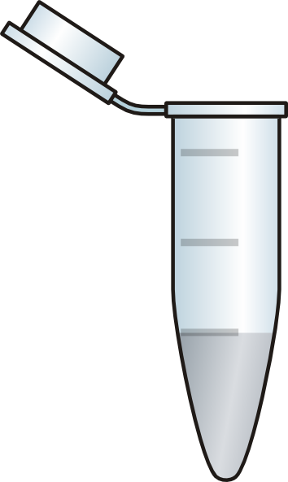
Experimental design: yeast cell cycle (cont’d)
TIME
MAKE RNA

Slide 13
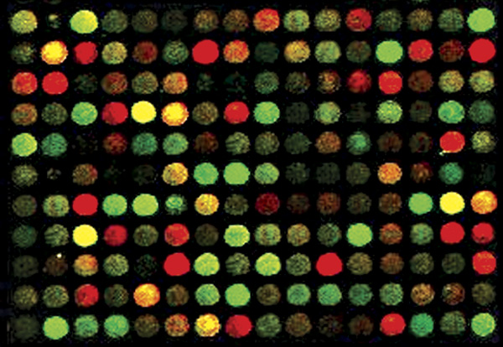
Basics of microarrays
DNA attached to _____________
Glass or plastic
RNA is _________
Usually indirectly
Bound DNA is the ____________
Labeled RNA is the “target”
3.29

Slide 14
Hybridization
Measurements of RNA abundance by microarrays based on ________________
Between __________________strands of RNA and DNA
Or two complementary DNA strands
Movie: microarray animation*
*Thanks to Dr. Malcom Campbell, Davidson College!

Slide 15
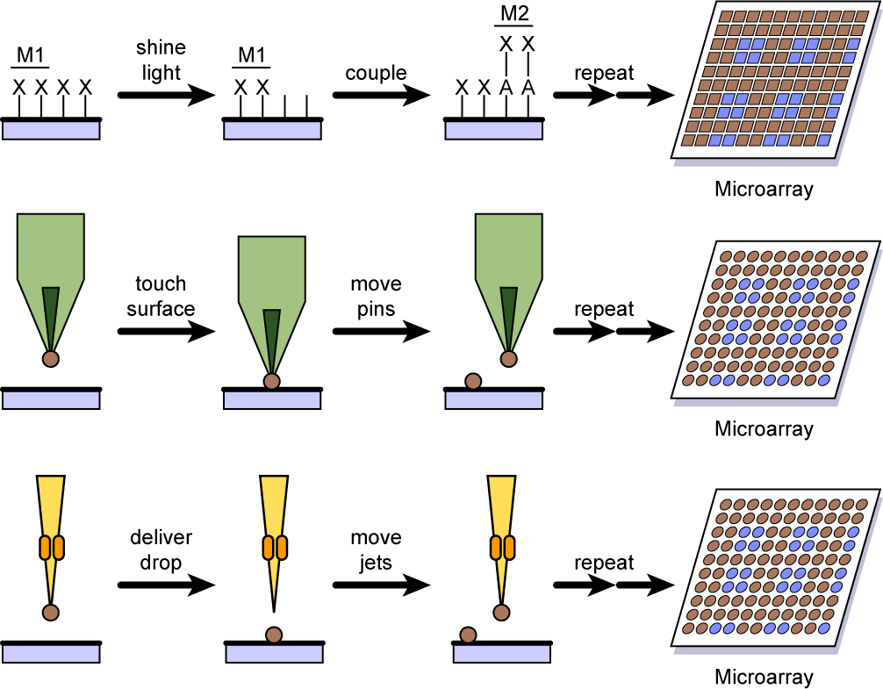
How microarrays are made: Affymetrix GeneChips
________________synthesized on silicon chip
One base at a time
Uses process of _______________________
Developed for printing computer circuits
3.30
Notes:
The synthesis of oligonucleotides directly on a solid support was pioneered by Affymetrix®. The synthesis is performed by photolithography, a process that is used to print computer circuits—hence the name for the Affymetrix microarrays: “GeneChips®.”

Slide 16
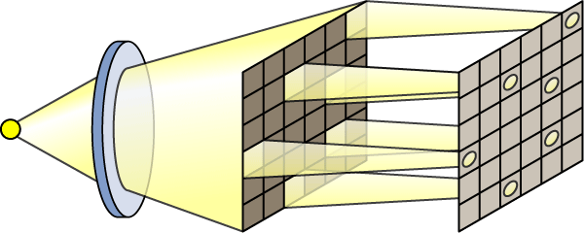
Photolithography
Light-activated _____________ reaction
For addition of bases to growing oligonucleotide
Custom _______________
Prevent light from reaching spots where bases not wanted
Mirrors also used
NimbleGen™ uses this approach
lamp
mask
chip
3.31
Notes:
In photolithography, each step of the oligonucleotide synthesis process is activated by light. In the Affymetrix manufacturing process, masks are used to allow bases to be added to growing oligonucleotides at specific locations on the chip. The masks prevent light from reaching locations on the silicon wafer where a base is not to be added that round. Instead of masks, digitally controlled mirrors can be used to shine light only on those spots where activation is desired. The biotechnology company, NimbleGen™ is using this approach to produce chips through photolithography.

Slide 17
Ink-jet printer microarrays
Ink-jet printhead draws up DNA
Printhead moves to specific location on solid support
__________ejected through small hole
Used to spot __________________________________________on glass slide
Use pioneered by Agilent Technologies, Inc.
3.34
Notes:
Another method for depositing DNA on glass slides is the use of ink-jet printer technology. Ink-jet printers are designed to deposit very small quantities of ink in precise locations. As adapted for microarray spotting, the printhead draws up a small amount of DNA, moves to a particular point on the slide, and ejects the DNA through a very small hole. This technology has also been adapted to provide for the synthesis of oligonucleotides on slides. After each base is added through the printhead to the growing oligonucleotide, the slide is washed free of excess nucleotides, and the exposed bases are primed for the addition of the next nucleotide. Agilent Technologies has pioneered the use of ink-jet printing for making microarrays. The primary drawback of this approach as compared with photolithography is that the maximum number of spots on a slide is far fewer with the ink-jet printing of DNA.

Slide 18
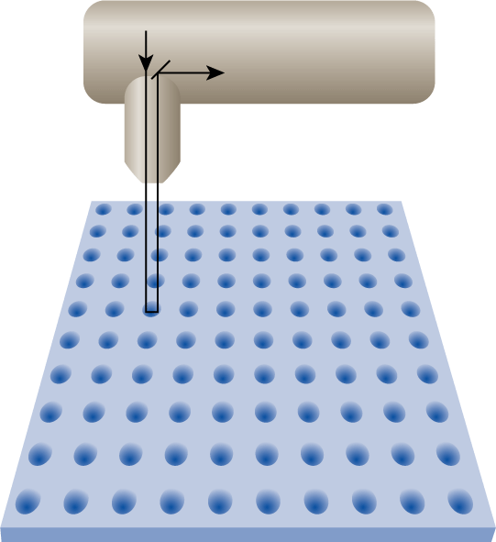
Scanning of microarrays
laser
__________________scanning microscopy
______________beam excites each spot of DNA
Amount of ________________detected
Different lasers used for different wavelengths
Cy3
Cy5
detection
3.38
Notes:
Confocal laser scanning microscopy is used to determine the amount of fluorescently labeled target that has hybridized to the DNA on the microarray. In this process, a laser beam is aimed at each spot on the microarray. The fluorescent light that is emitted upon excitation of the dye passes through a pinhole that effectively eliminates all surrounding light. This condition permits a precise determination of the level of fluorescence coming from the hybridized target at a single spot on the microarray. For competitive hybridization, the microarray is scanned twice, using different wavelengths for each of the fluorescent dyes Cy3 and Cy5.

Slide 19
RNA-seq
Illumina
seq movie
Ion torrent
http://vimeo.com/68069581
Notes:
Talk about advantages and disadvantages that were brought up in the movies.
-Illumina: HUGE coverage, massively parallel, ~600 billion bases per run. But slow (~1-3 days per run).
-ion torrent: fast, reasonable coverage. Good for microbial genome or transcriptome sequencing. But bad with high G+C DNA (semiconductor doesn’t deal well with homopolymers).

Slide 20
RNA–seq vs microarrays
RNA-Seq
Direct ________of cDNA (or RNA)
Direct ___________of RNA molecules – large dynamic range (detection of ________expressed genes).
No need to generate __________: advance knowledge of __________sequence not required
Microarrays
____________of cDNA to DNA probes.
Intensity relative quantitation of RNA to a control sample.
Signal can saturate – ________dynamic range.
__________sequence required

Slide 21
Data analysis preview
From scanner: _______________________per spot
Ratio calculation: _______________ vs ___________________
Analysis: _________________expressed genes, ______________, ______________________.

Slide 22
Transcriptome results
How do we interpret the data?
How did Spellman and colleagues intepret their data?

Slide 23
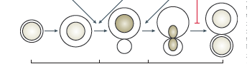

Cell cycle
G1 phase
S
M

Slide 24
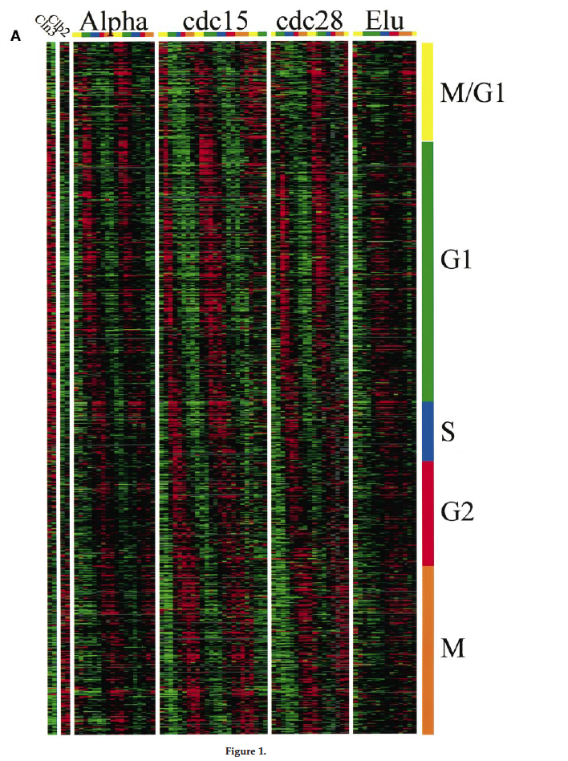
What Spellman and colleagues observed
time
genes
=
Amount of RNA
time
“_____________gene expression”

Slide 25
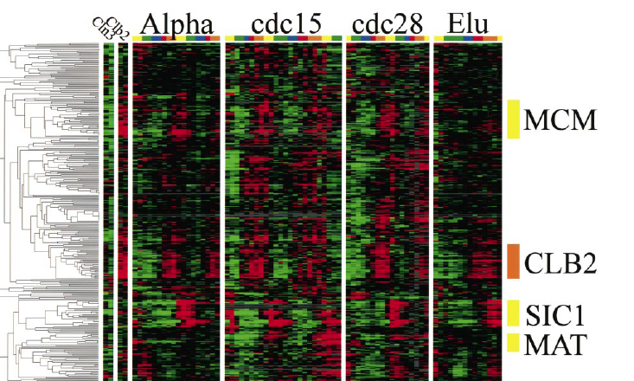
How are the genes turning on and off?

Slide 26
Conclusions
Genes are expressed according to the _________________.
A set of _________________________regulates these genes (turns them on and off).
The ___________________themselves respond to the cell cycle (phosphorylation by ___________________-)
***Groups of genes with _______________________tend to be expressed in __________________(Clusters).

